Slide 1
E-Governance Smart City Geographical Information System(GIS)

Slide 2
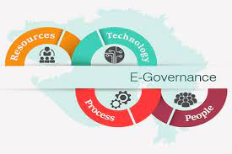
E-Governance

Slide 3
E-Governance
E-Governance expands to Electronic Governance.
Application of ICT(Information and Communication Technology) for delivering government services.
Enhancement of traditional government.
Delivers SMART government.
S-Smart
M-Moral
A-Accessible
R-Responsive
T-Transparent

Slide 4
Purpose of e-governance
To promote good governance.
To simplify government procedures.
To access to government services.
To enhance ability to address public needs.

Slide 5
Models of e-governance
G2C(Government to Citizens)
Between government and citizens.
Example: online driving license system,NID Pre-Enrollment system etc.
G2G(Government to Government)
Exchange of Information between government agencies.
Interactions may be diplomatic ties, economic alliance etc.
Improves efficiency in data sharing.

Slide 6
G2B(Government to Business)
Between government and business organizations.
Example: Nepal Trade Information Portal, OCR eservices etc.
G2E(Government to Employees)
Interaction between government and employees.
Support transactions such as payroll and pension plans.

Slide 7
Benefits of E-governance
Revenue Growth
Enhances transparency, efficiency and accountability
Cost reduction
Greater convenience
Expands reach of governance

Slide 8
Drawbacks of e-governance
Cyber-security Risks
Privacy concerns
Digital illiteracy
Cost of implementation and maintenance
Legal and regulatory challenges

Slide 9


